Slide 1
Basic descriptives

Slide 2
Store master file descriptives
This is the master file containing description of 403 stores, location carpet area, etc
Unlike the other files, it is likely this is the full file and will remain unchanged even after we procure the full data

Slide 3
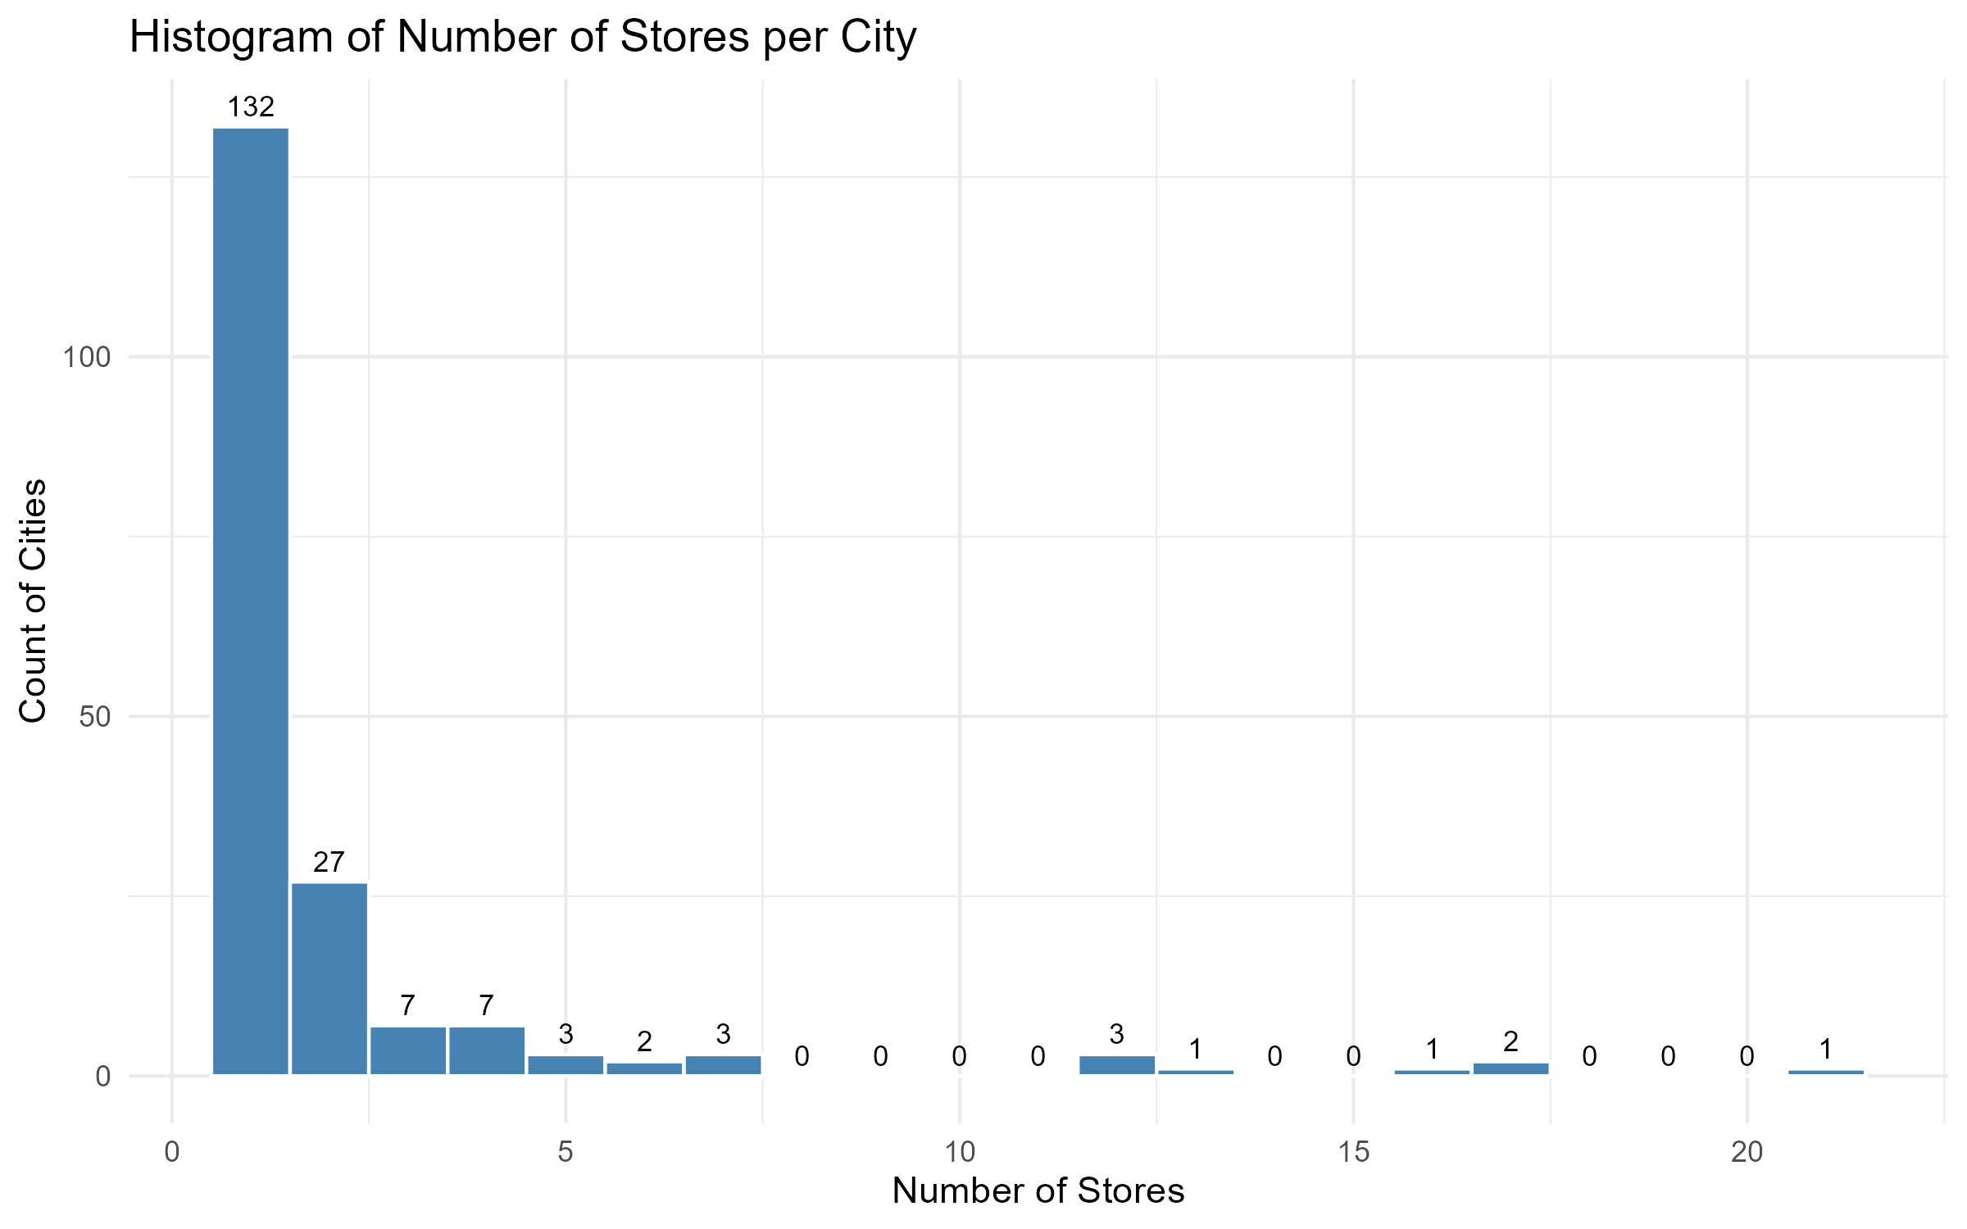
Hist Num Stores

Slide 4
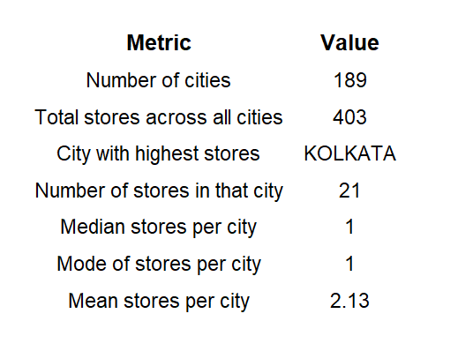
City Summary Metrics

Slide 5
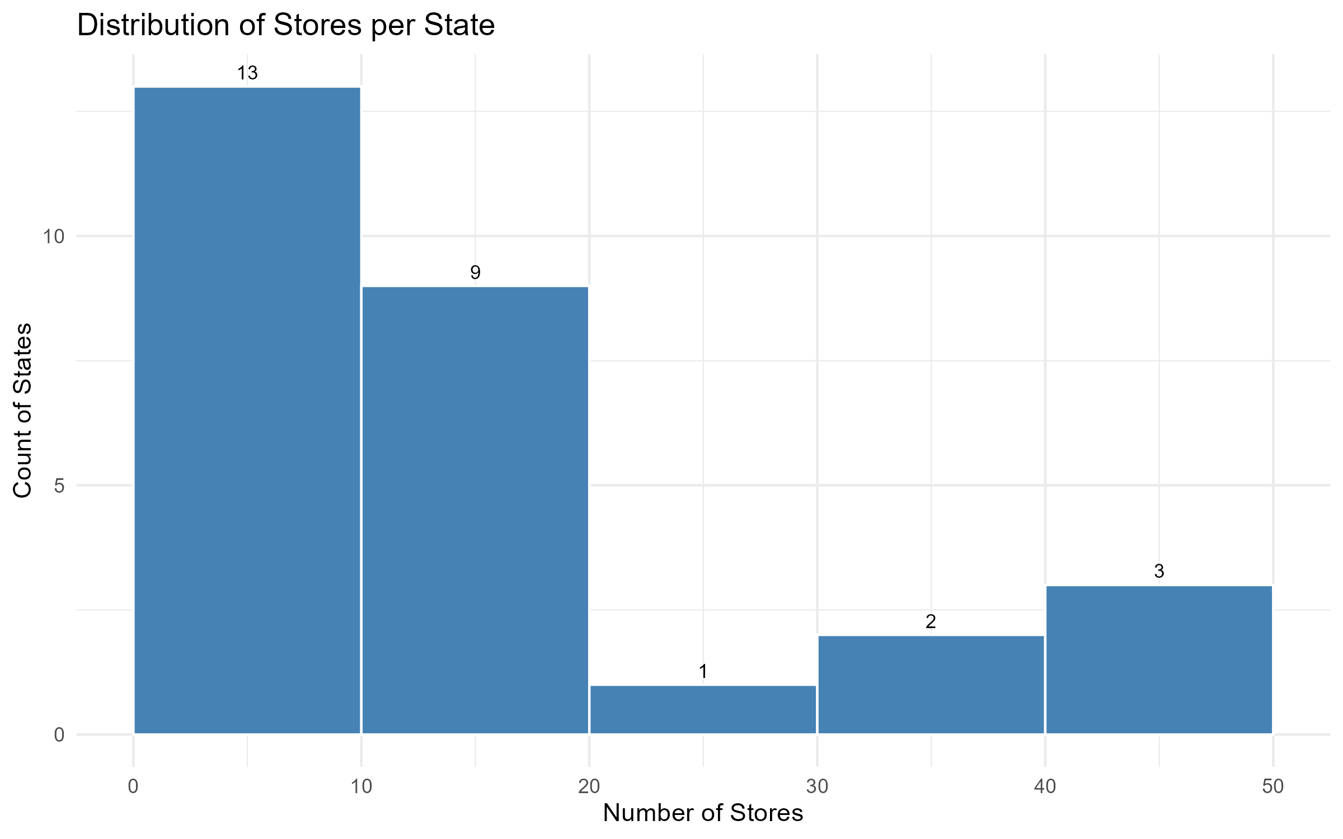
Hist Stores Per State

Slide 6
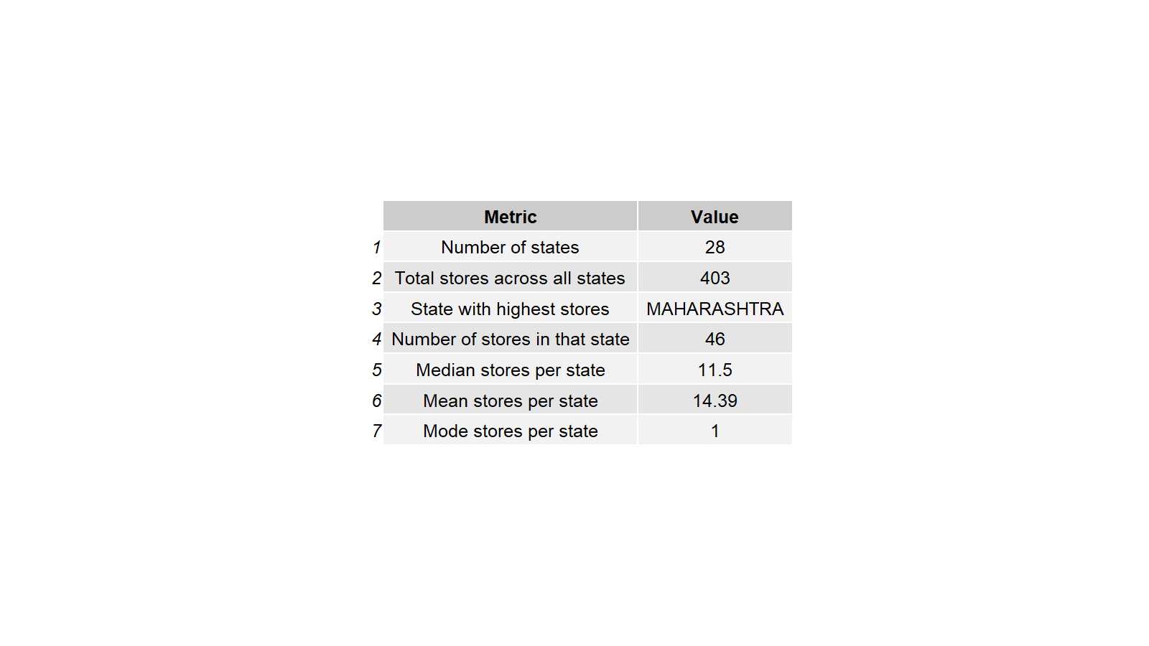
State Summary Metrics

Slide 7
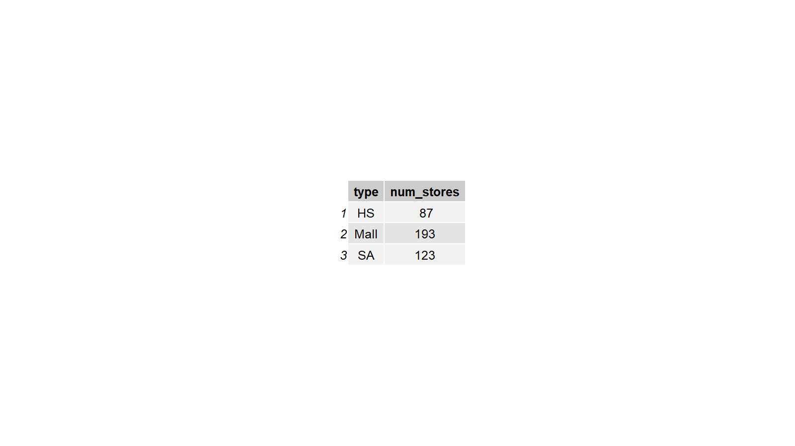
Type Summary Table

Slide 8
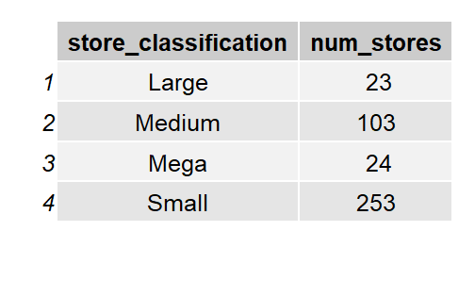
Classification Summary Table

Slide 9
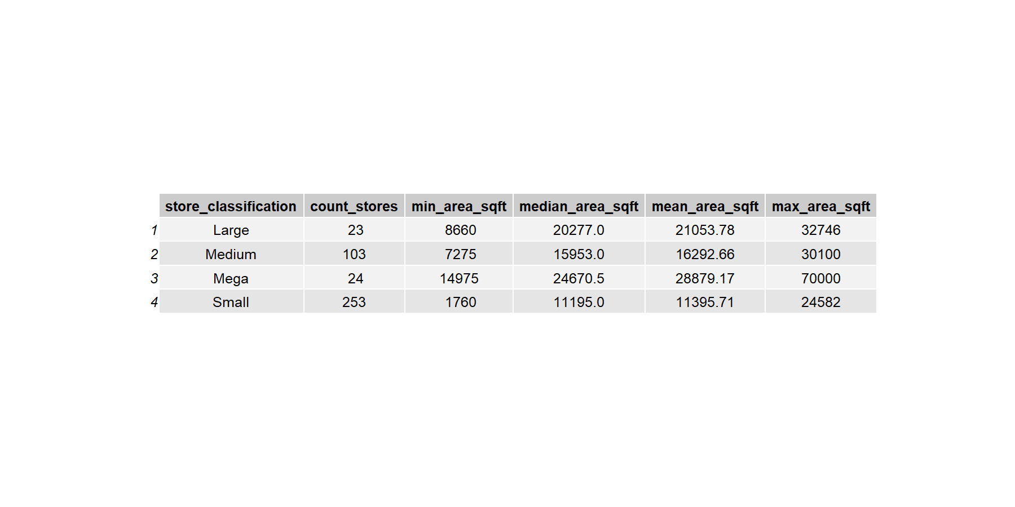
Classification Vs Area Table

Slide 10
NOB and footfall descriptives
149 store
86 weeks – 52 in 2024 and 34 in 2025

Slide 11
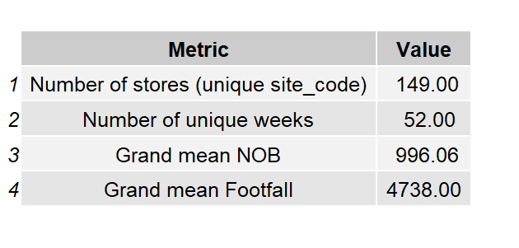
Overall Metrics Table
86 = 52+34

Slide 12
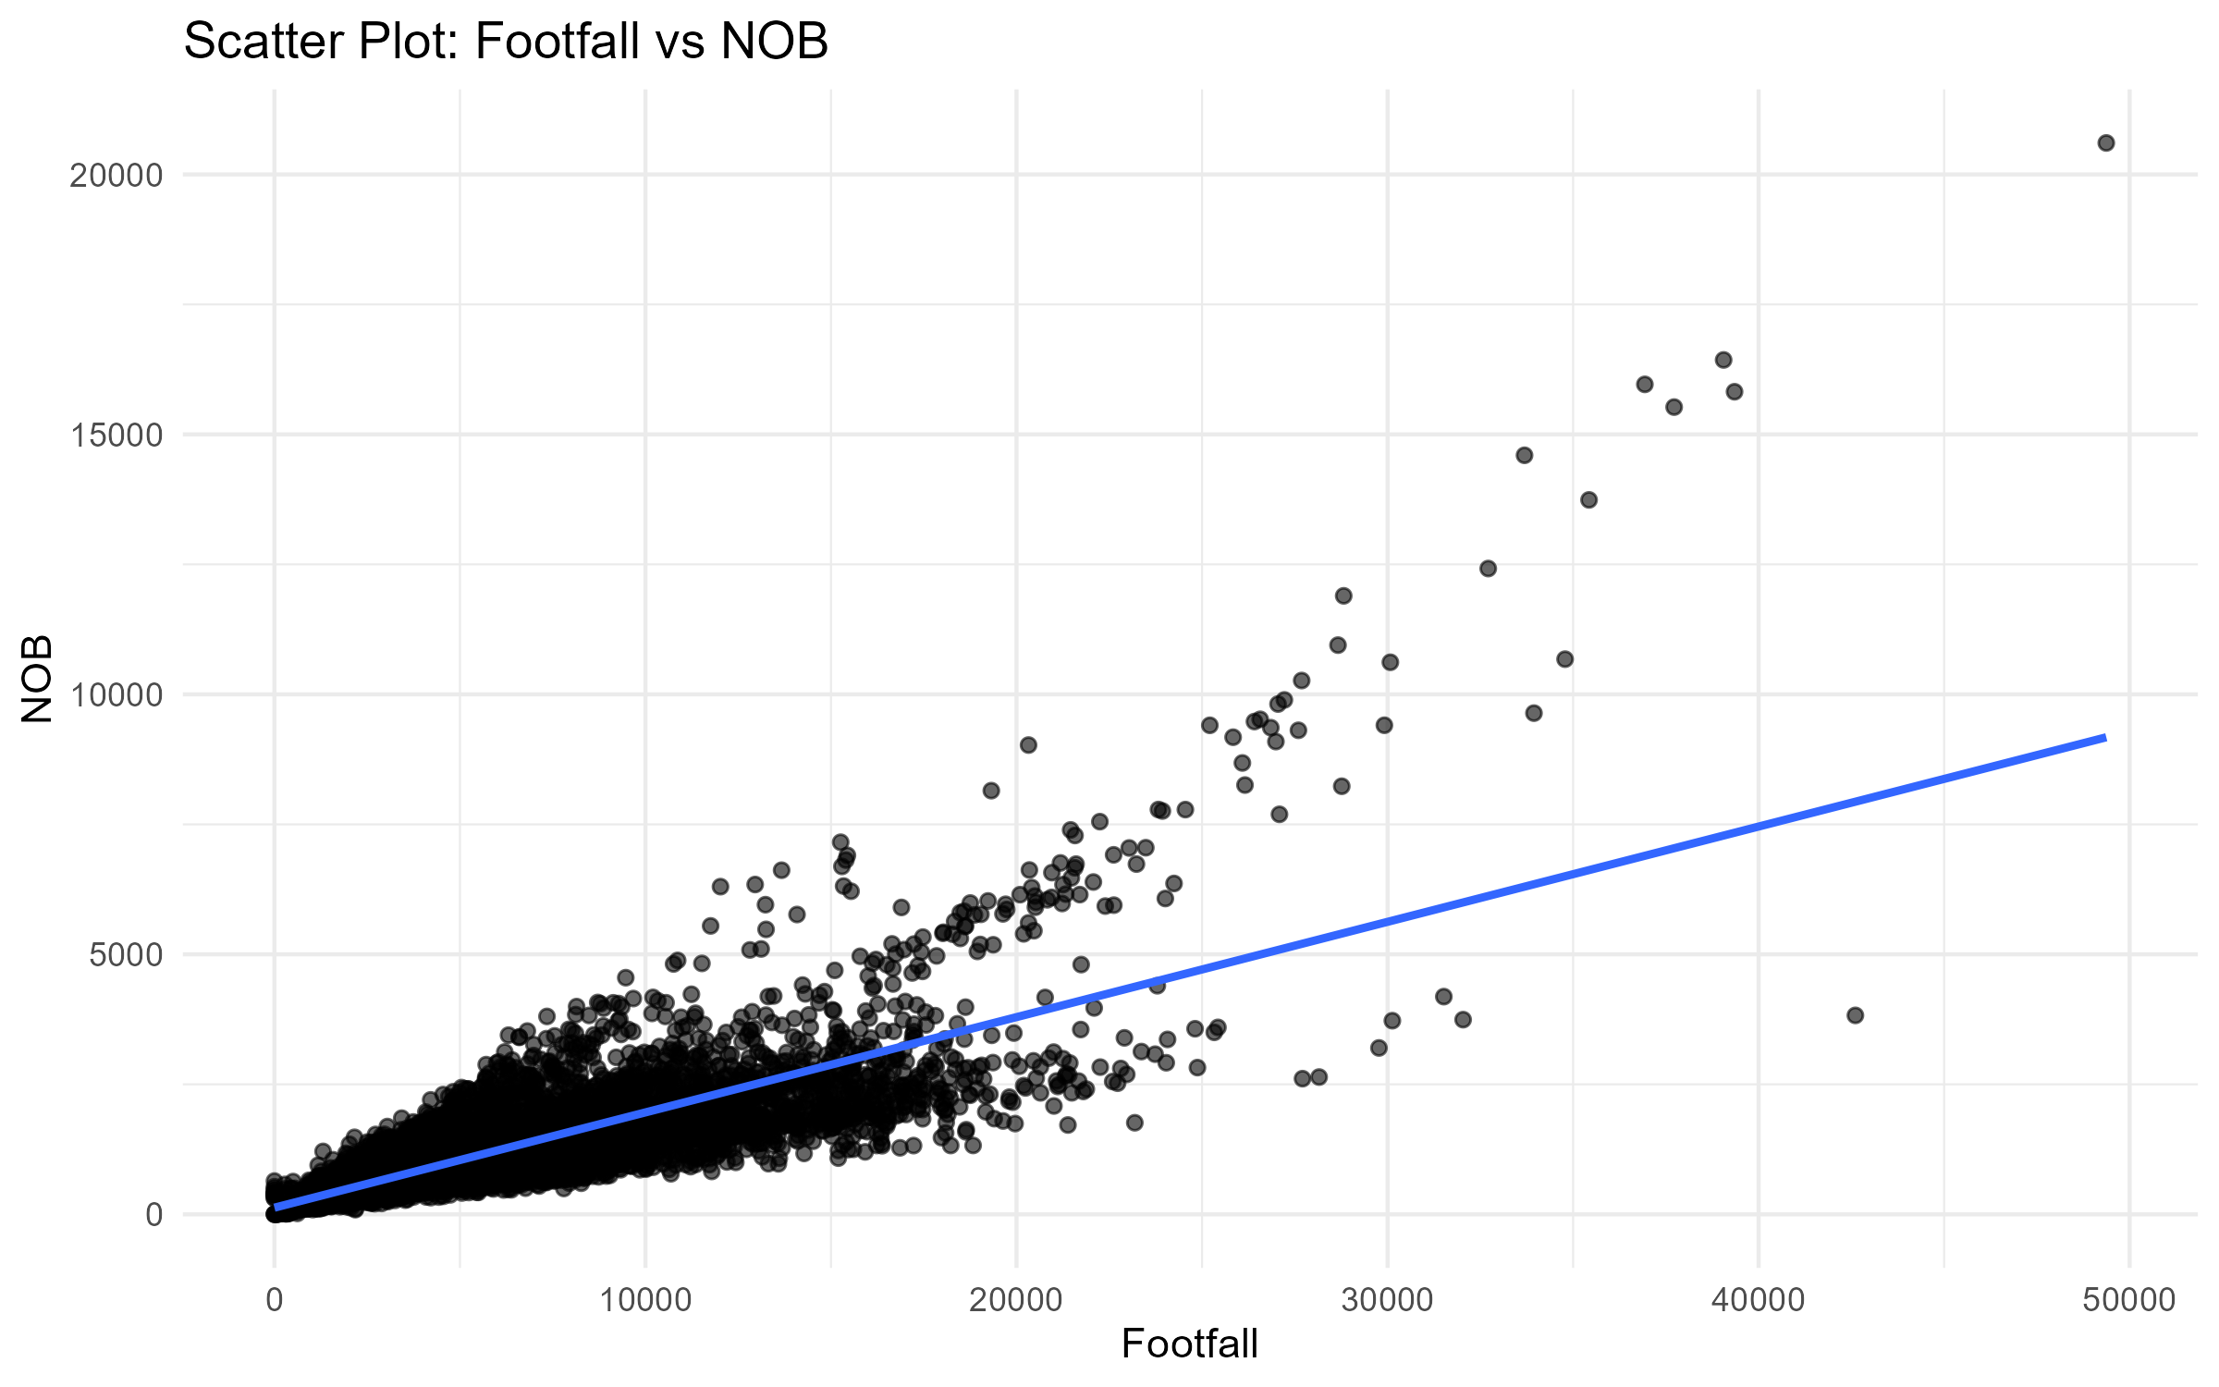
Scatter Nob Vs Footfall

Slide 13
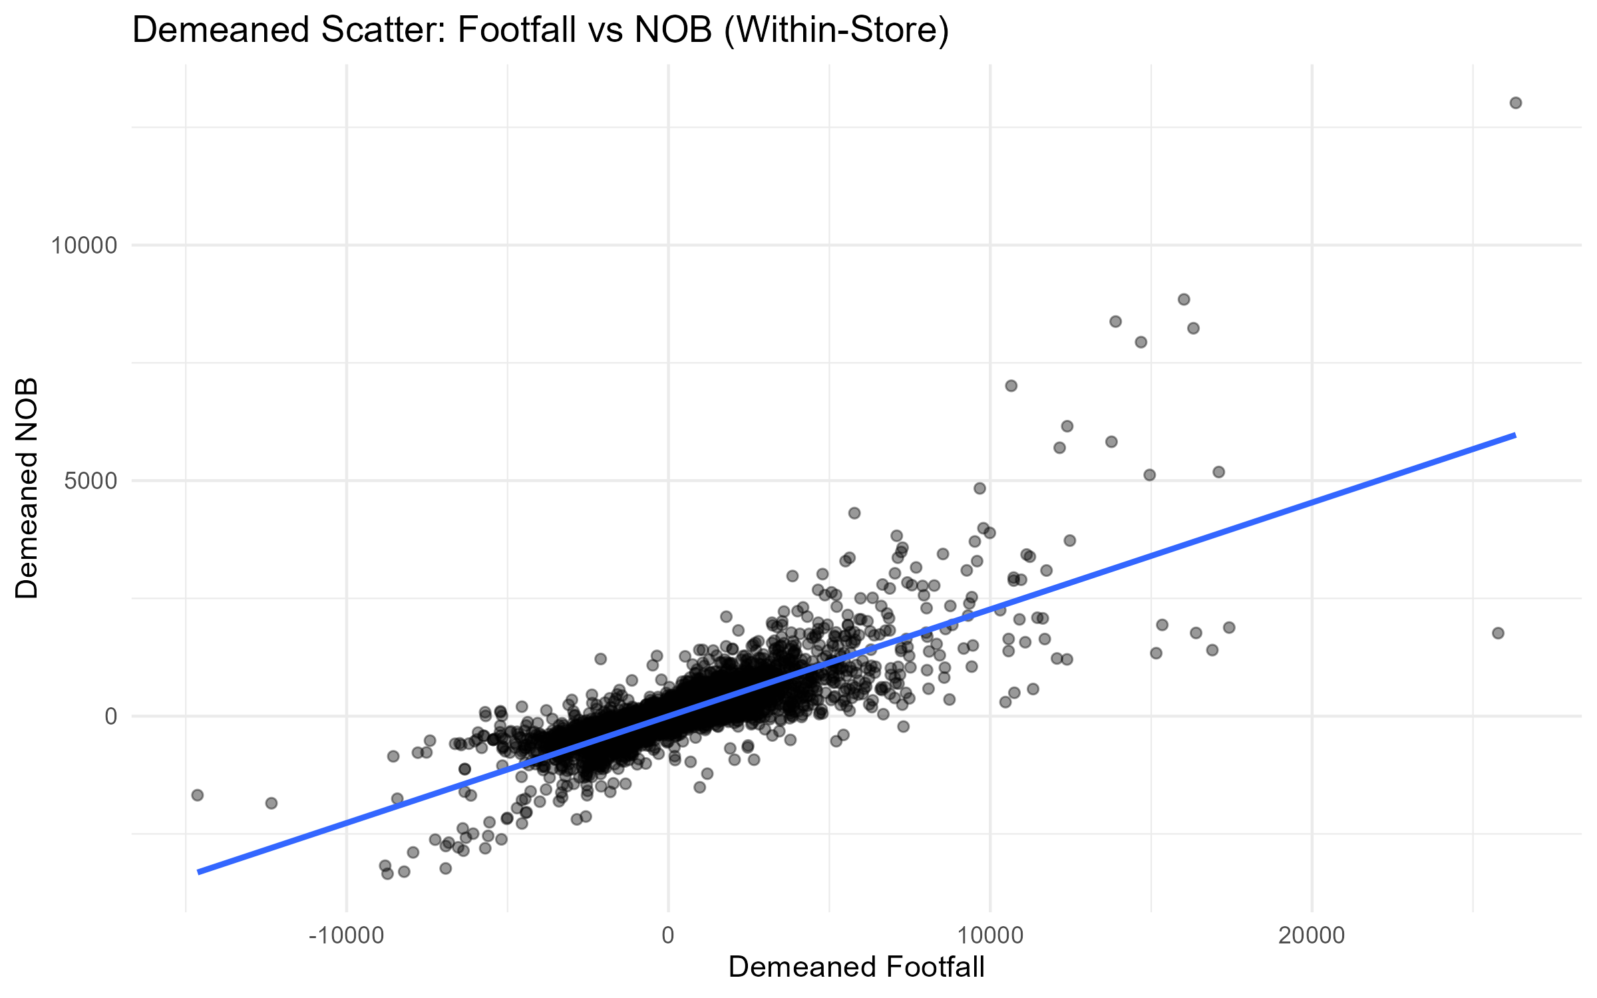
Demeaned Scatter Footfall Vs Nob

Slide 14
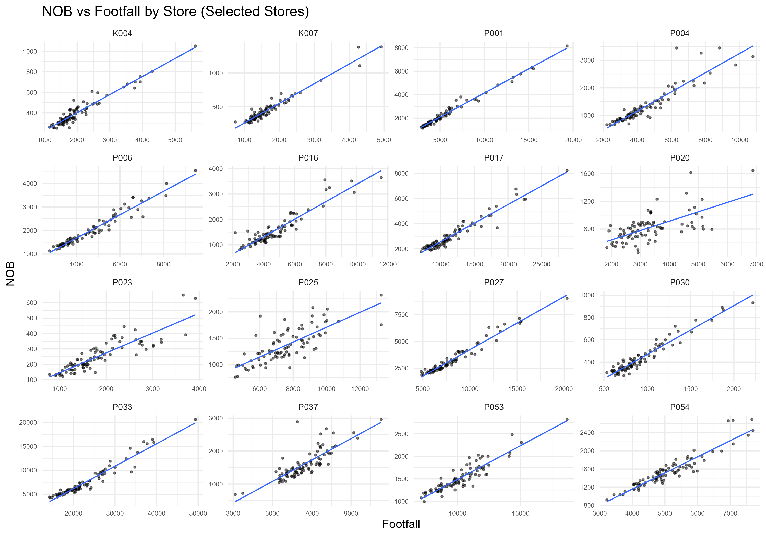
Nob Vs Footfall Store Panels

Slide 15
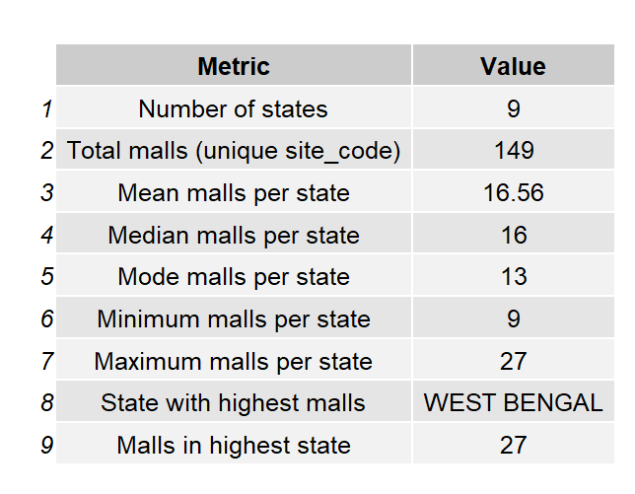
State Mall Metrics Table

Slide 16
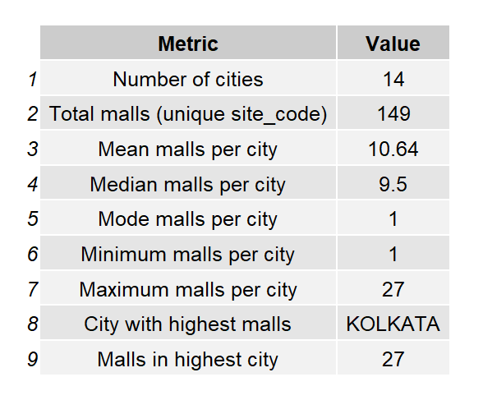
City Mall Metrics Table

Slide 17
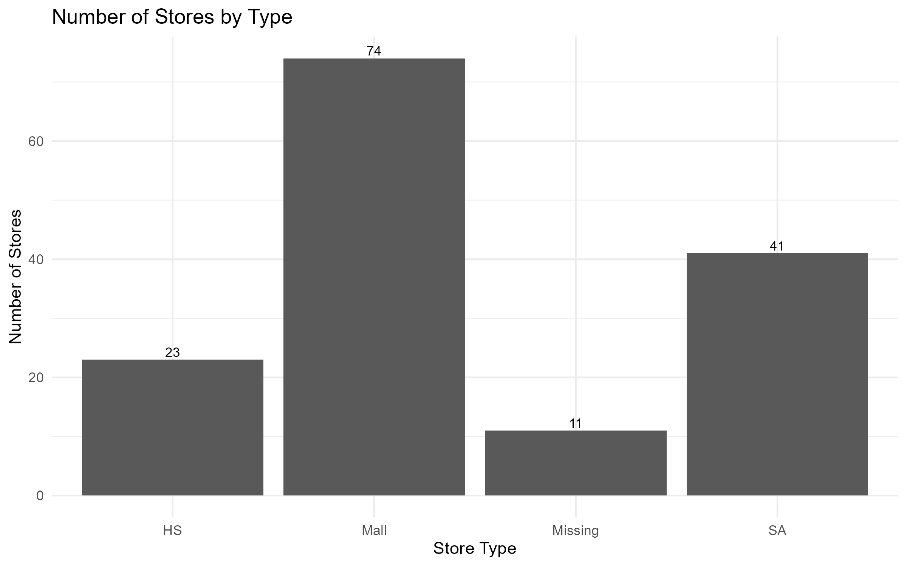
Store Type Distribution

Slide 18
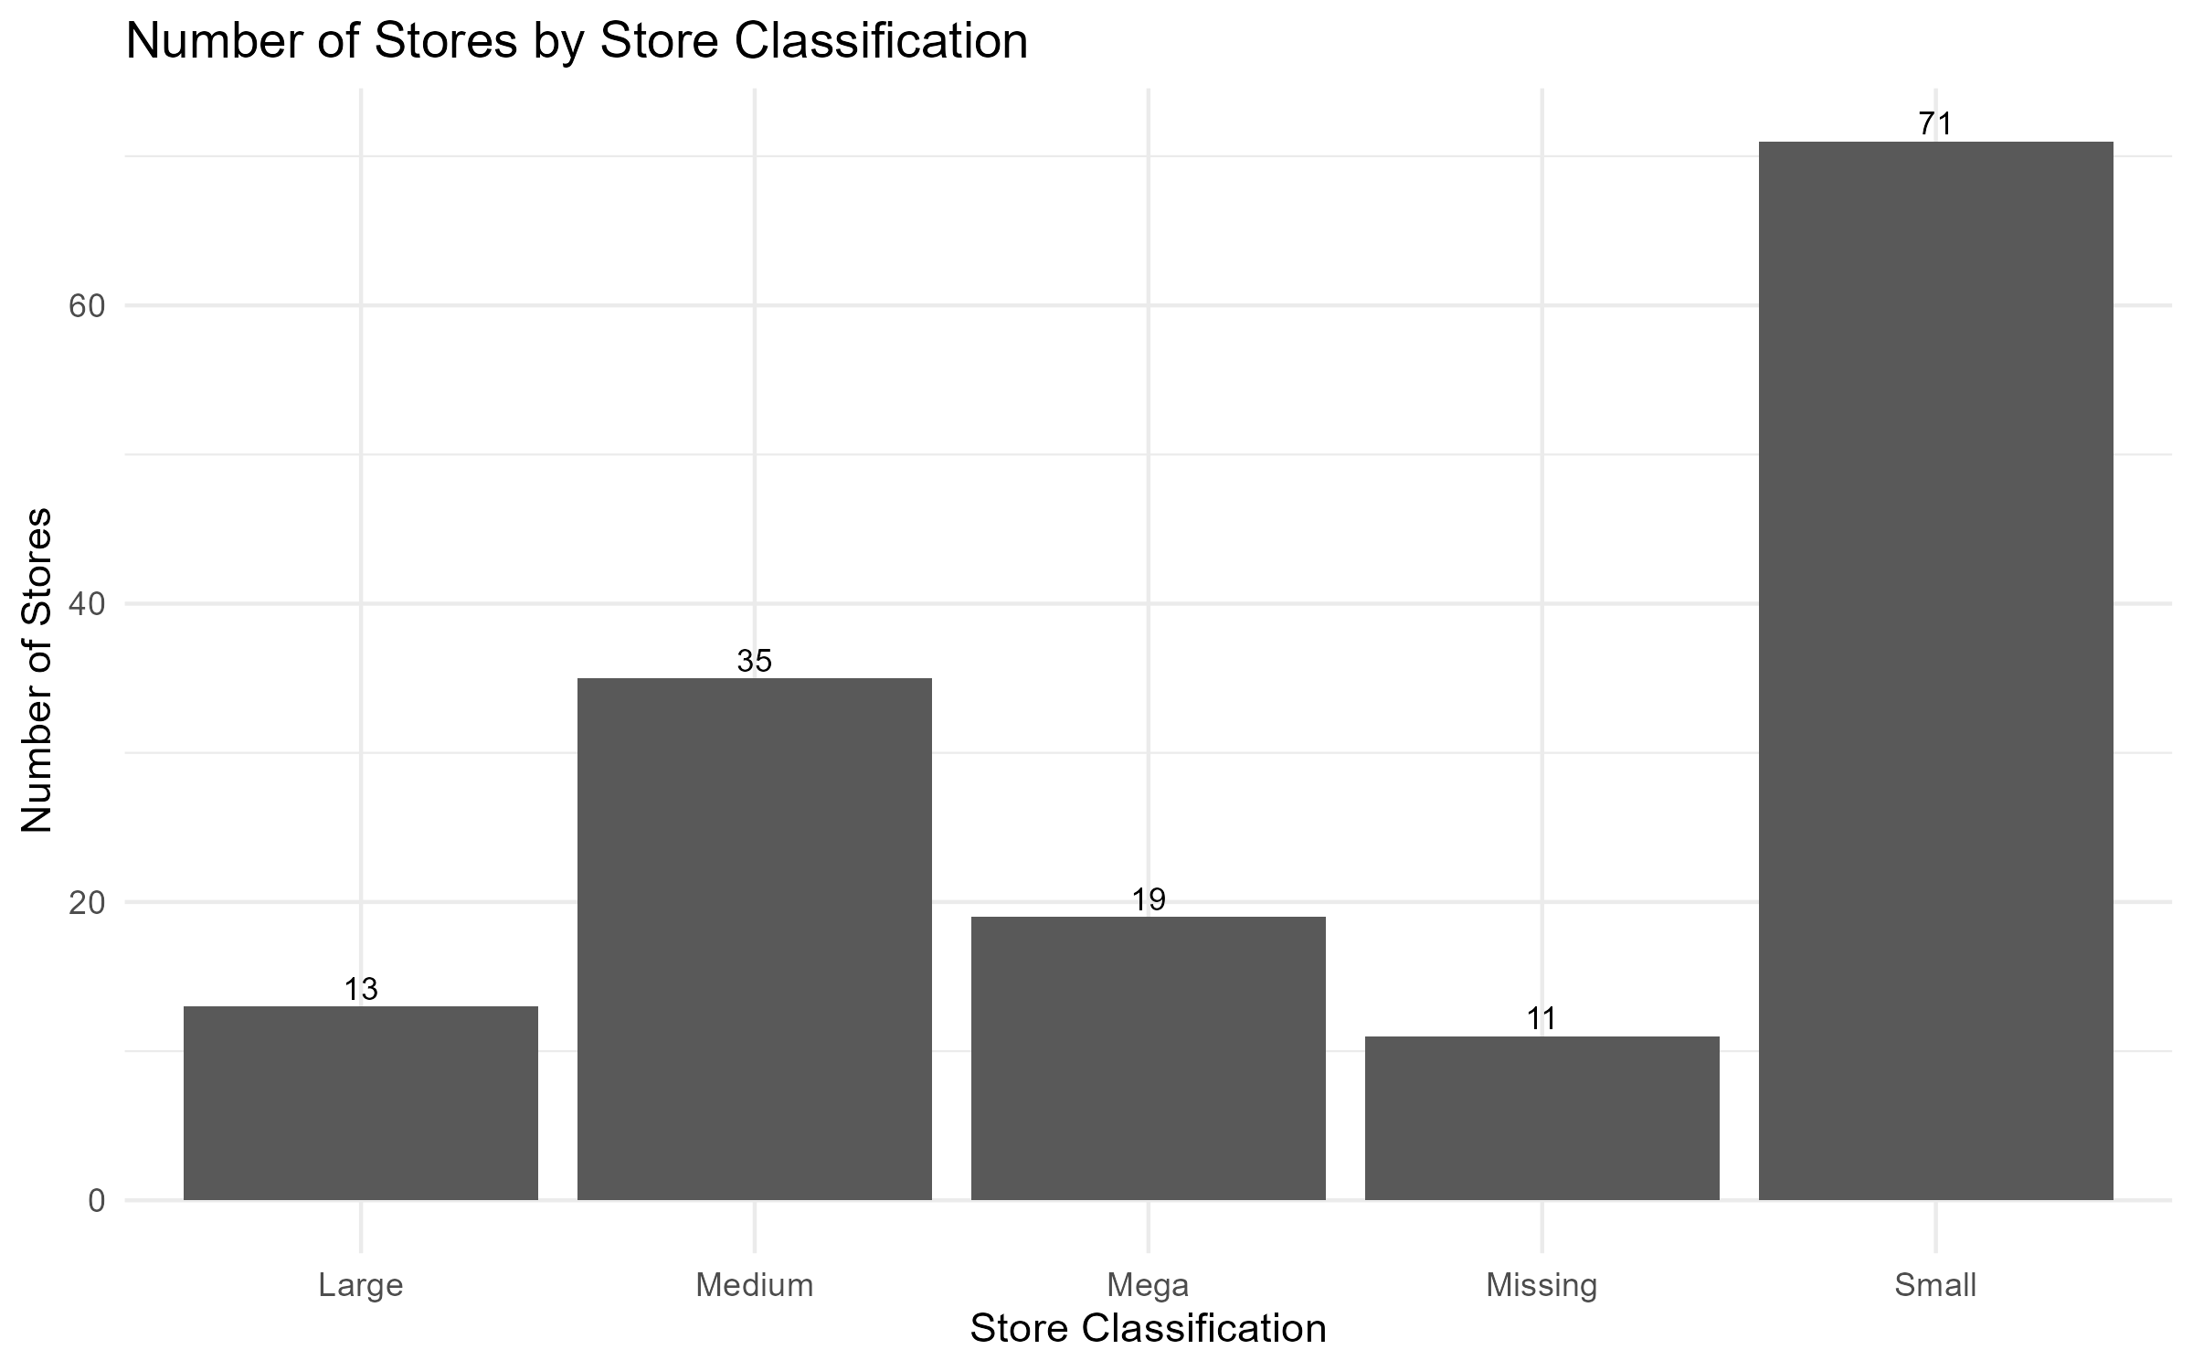
Store Classification Distribution

Slide 19
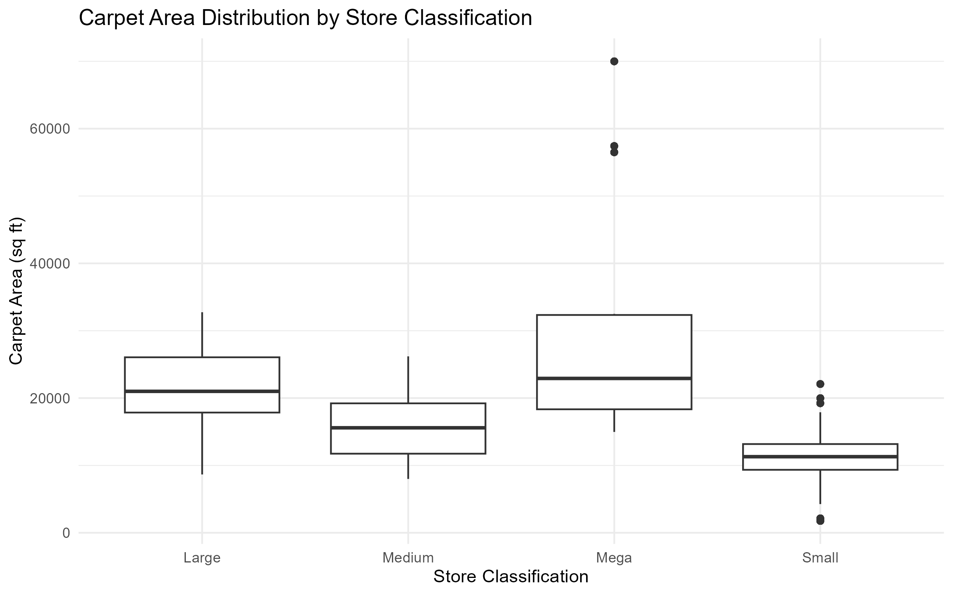
Area By Store Classification Boxplot

Slide 20
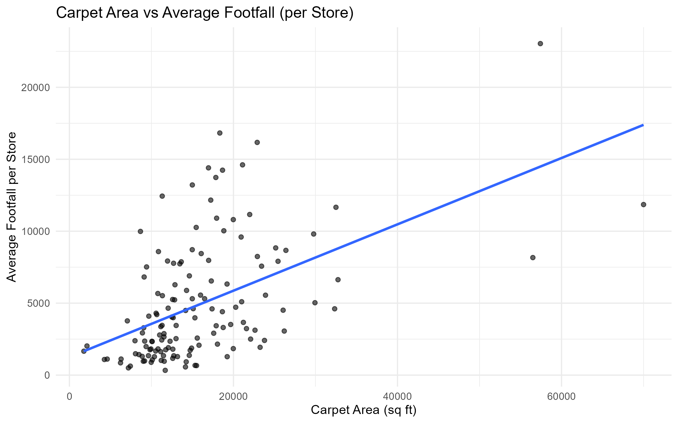
Carpet Area Vs Avg Footfall

Slide 21
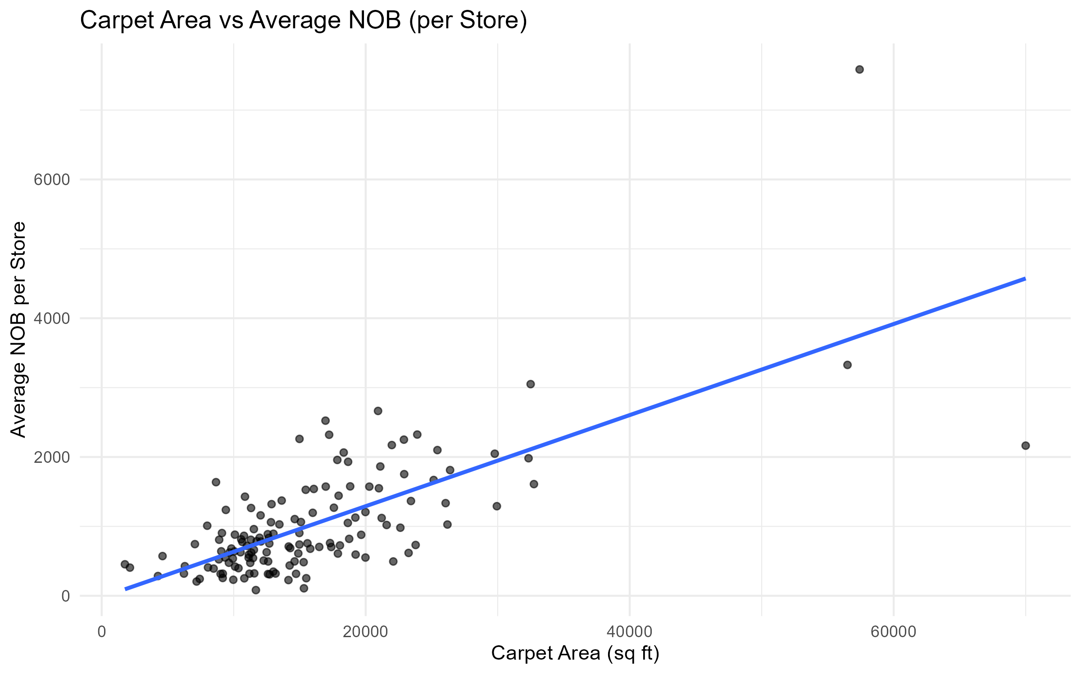
Carpet Area Vs Avg Nob

Slide 22
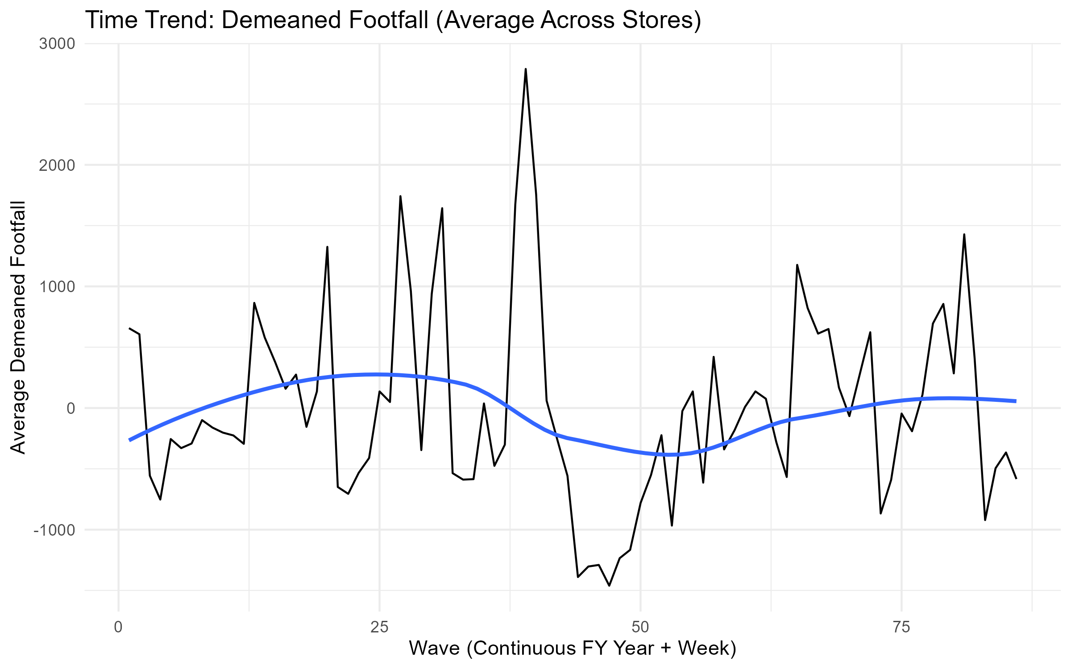
Wave Vs Demeaned Footfall
Notes:
First took deameaned footfall for each store
Then averaged the demeaned footfall each month

Slide 23
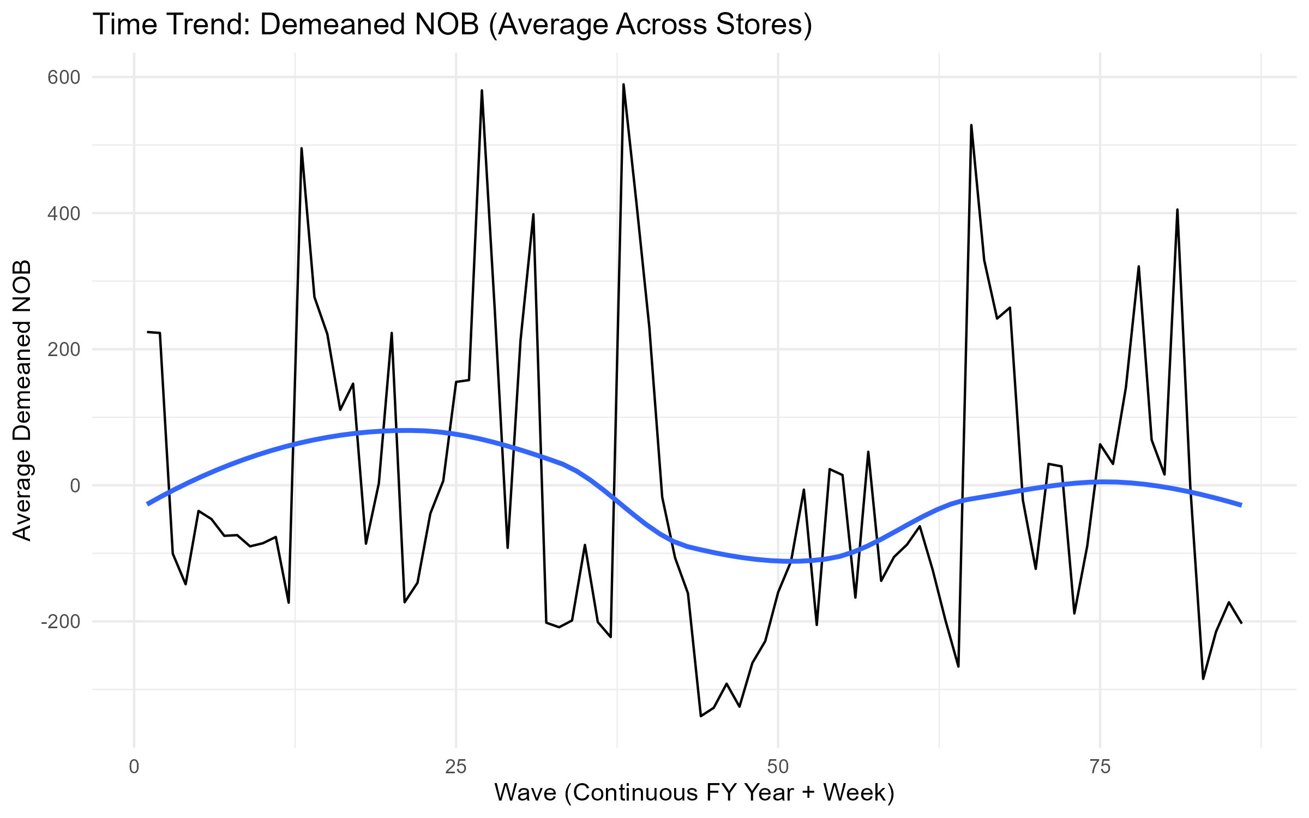
Wave Vs Demeaned Nob

Slide 24
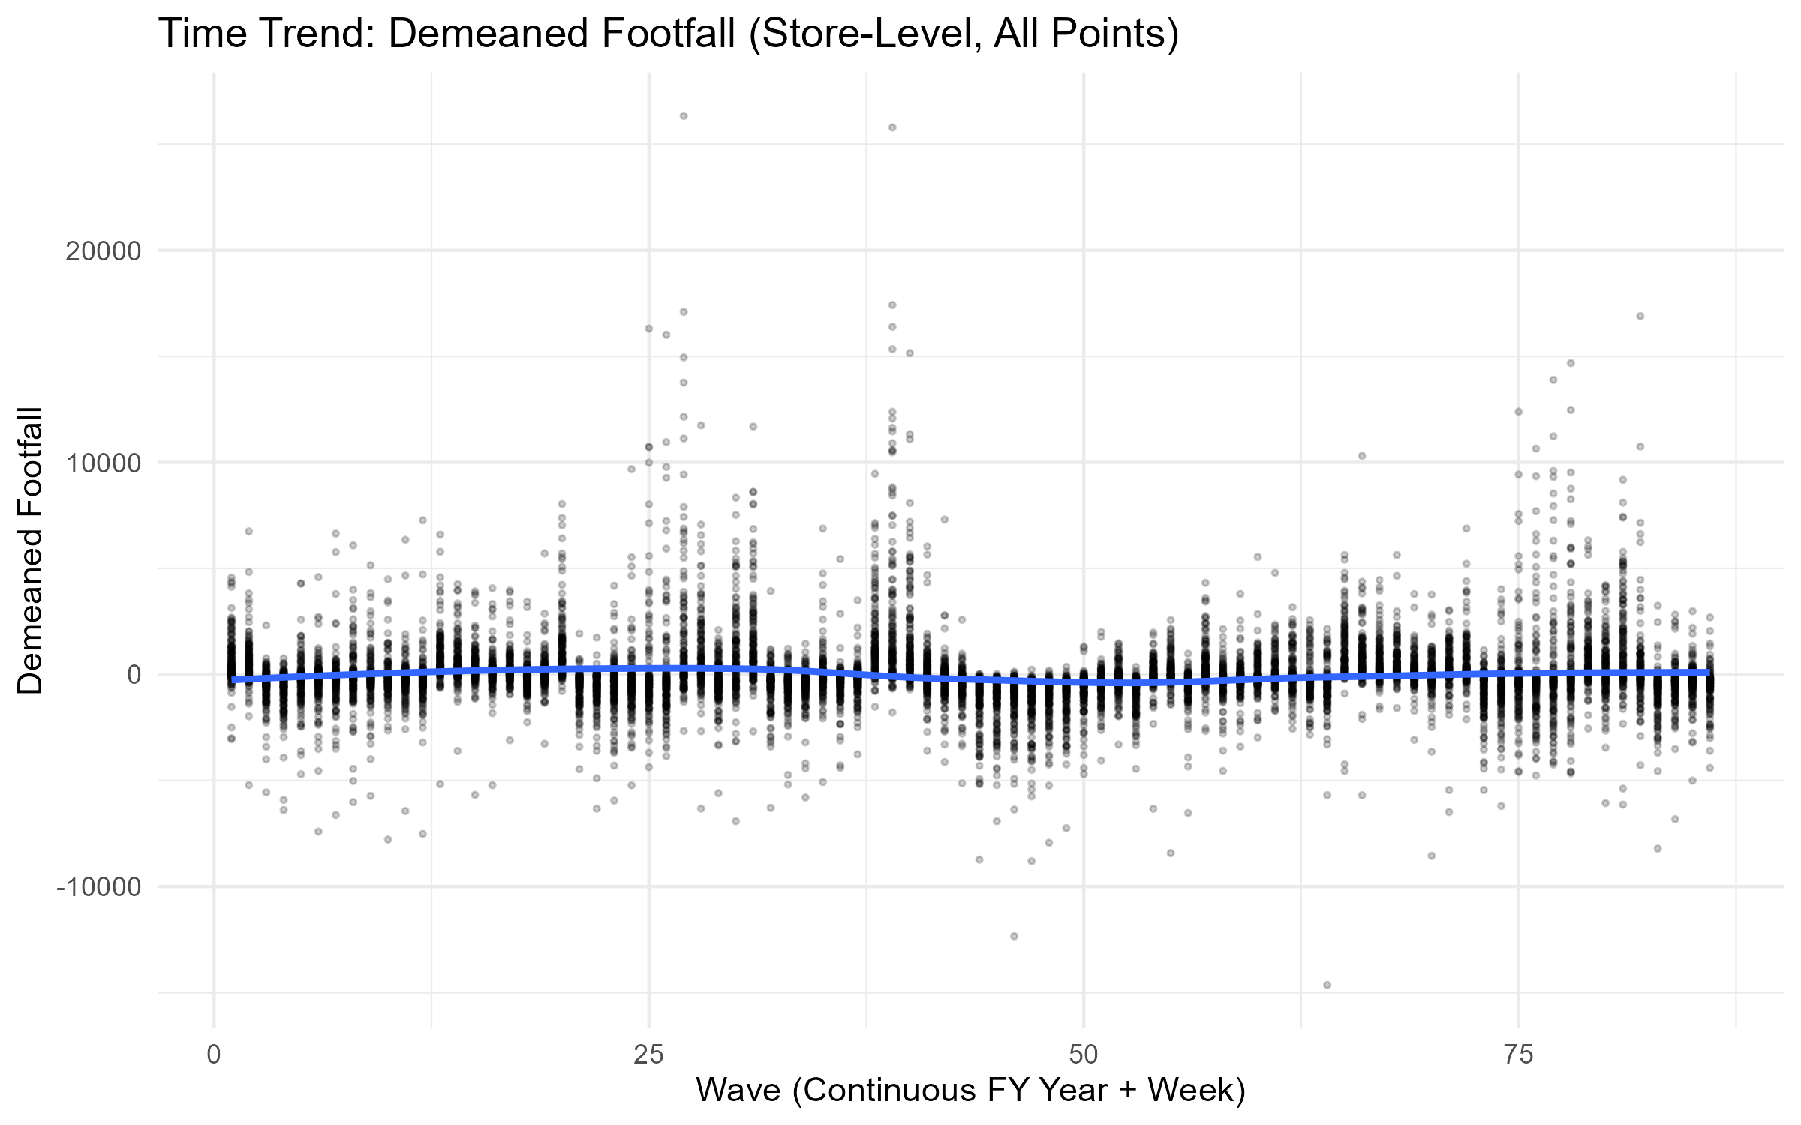
Wave Vs Demeaned Footfall Points

Slide 25
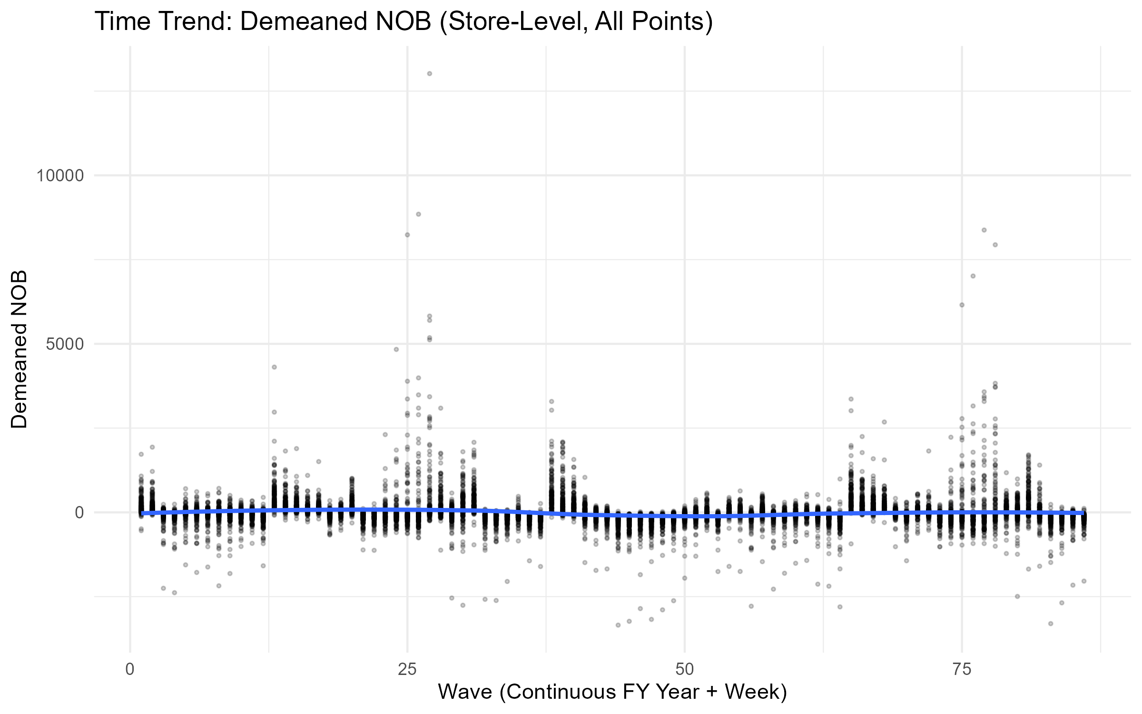
Wave Vs Demeaned Nob Points

Slide 26
Sales data summary
We have the sales data for a single store (the Ghatkopar store)
2 weeks of data – Week 34 in 2024 and 2025

Slide 27
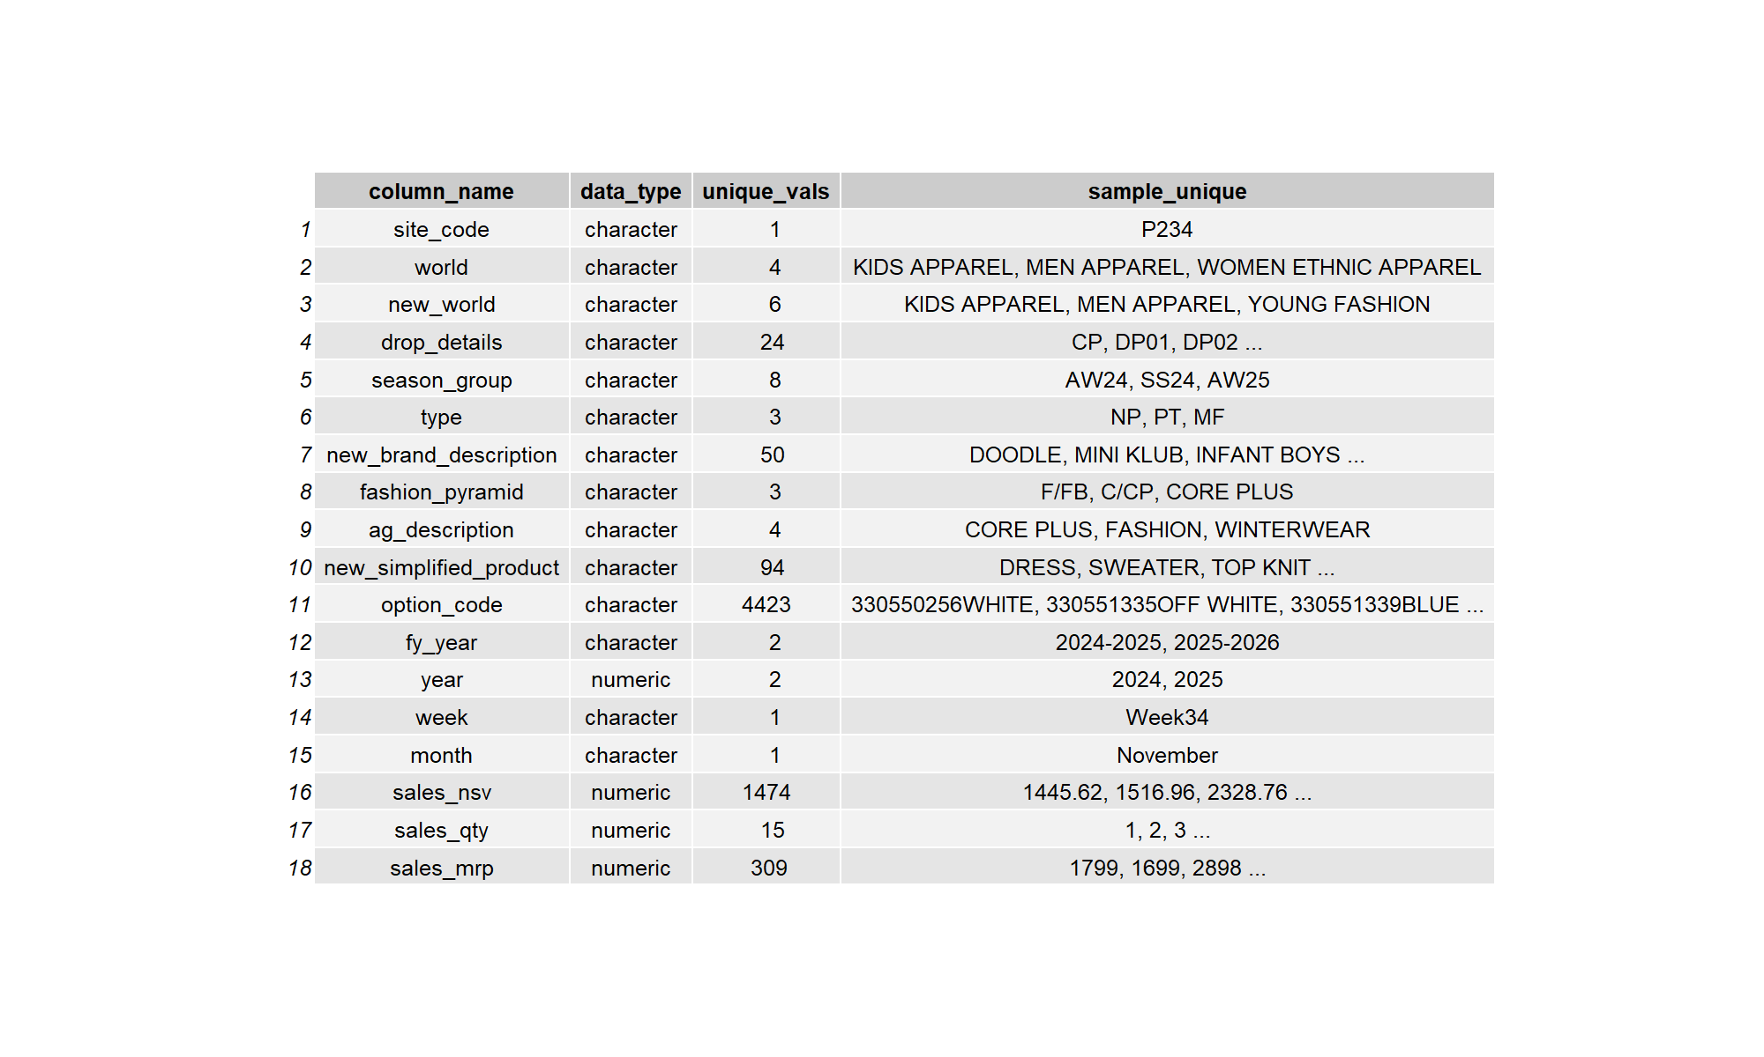
Columns Summary

Slide 28
Only 2025 data
The following descriptives are only for the 2025 data

Slide 29
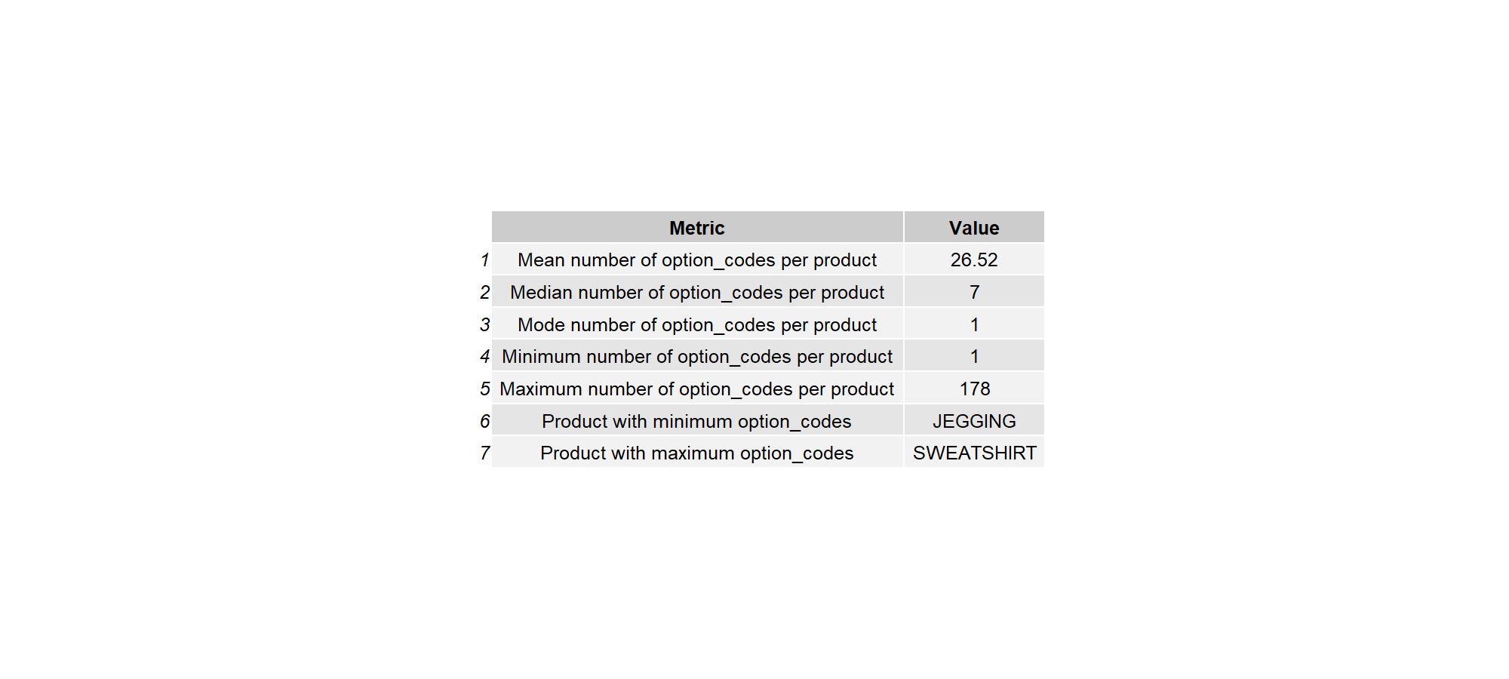
Product Option Descriptives 2025

Slide 30
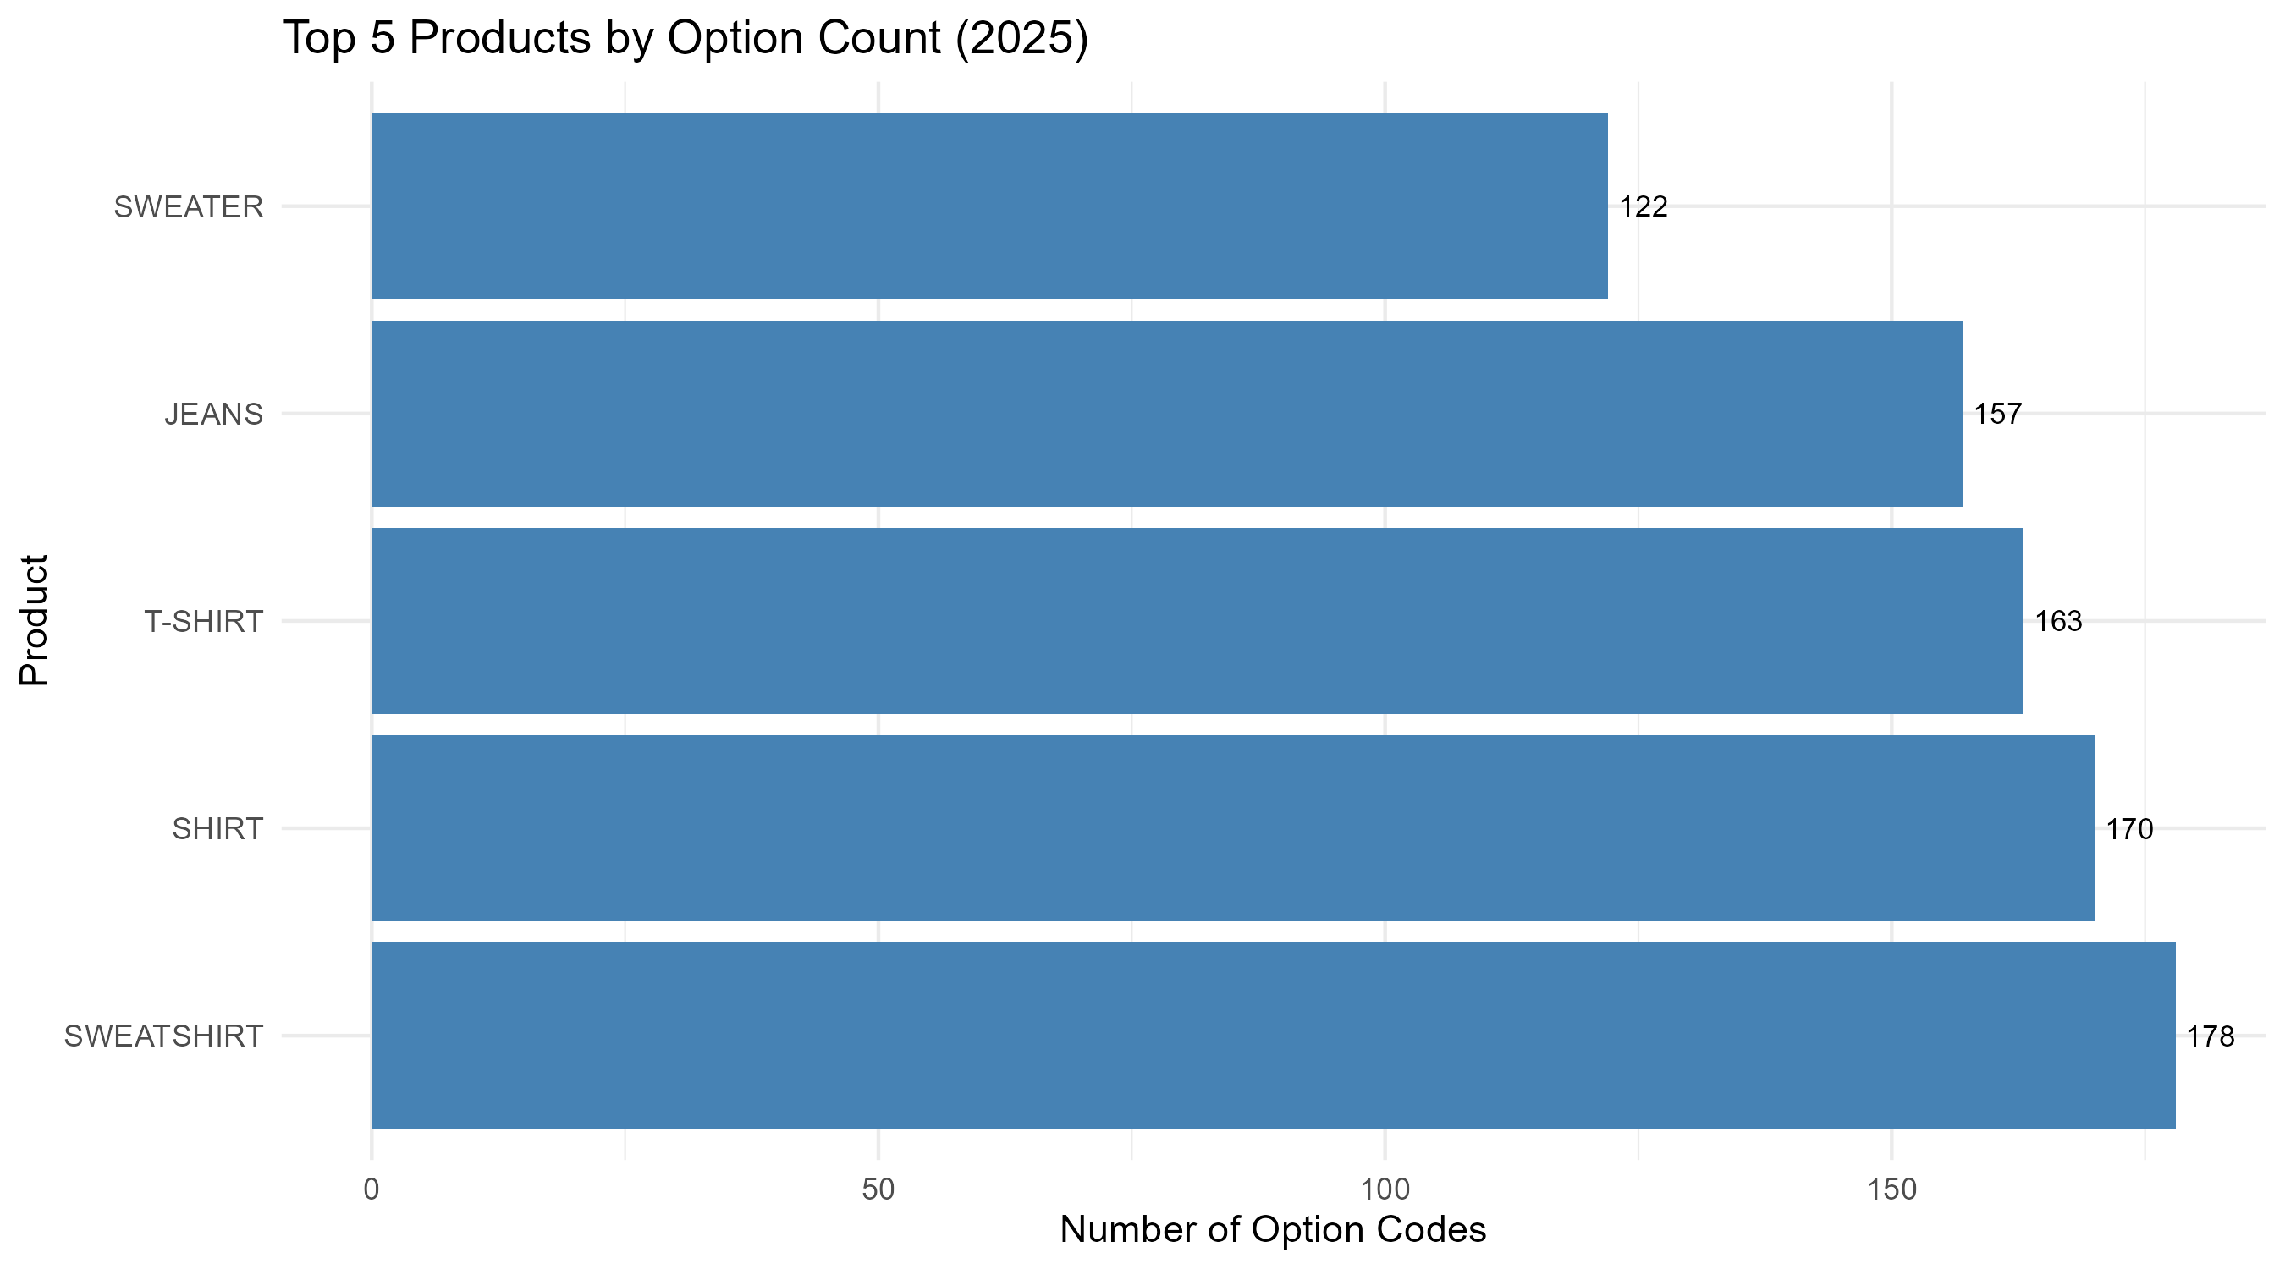
Top5 Products Option Count

Slide 31
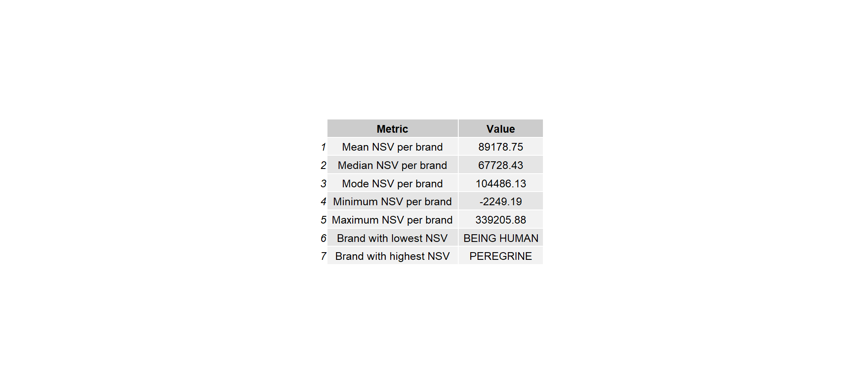
Brand Nsv Summary

Slide 32
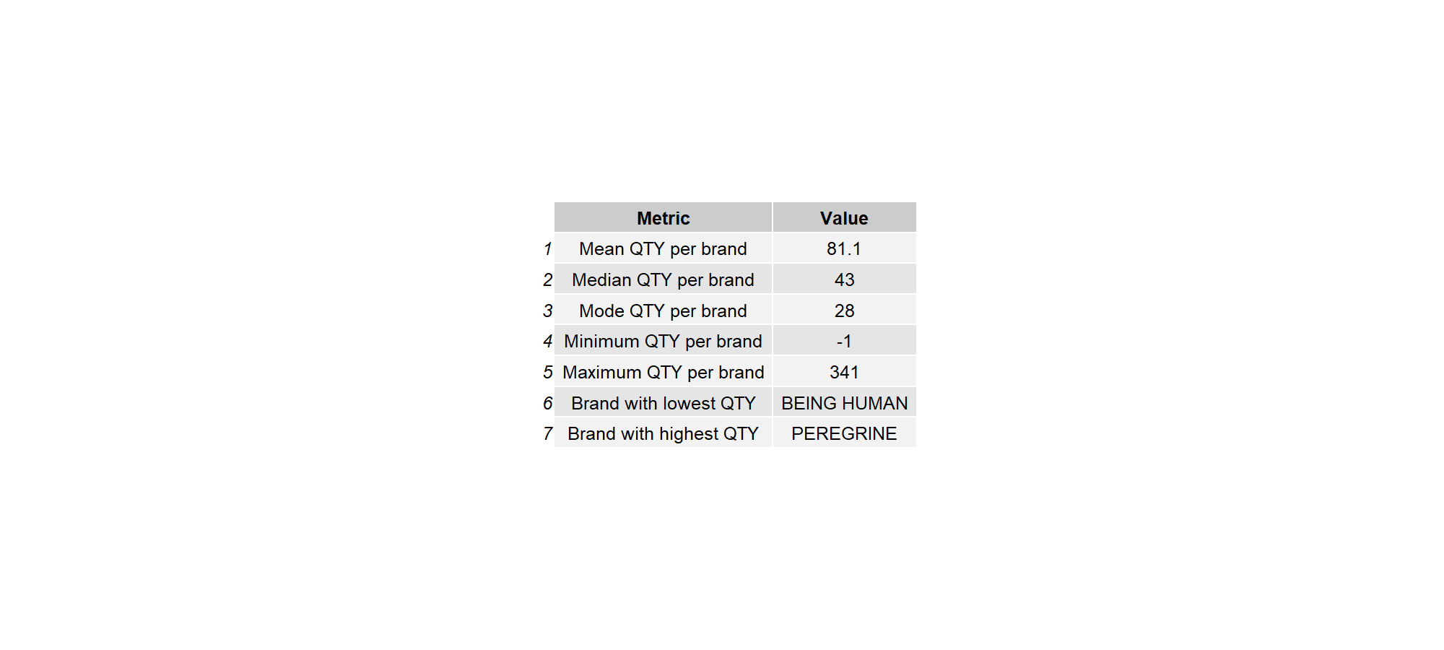
Brand Qty Summary

Slide 33

Type Vs Sales Summary

Slide 34
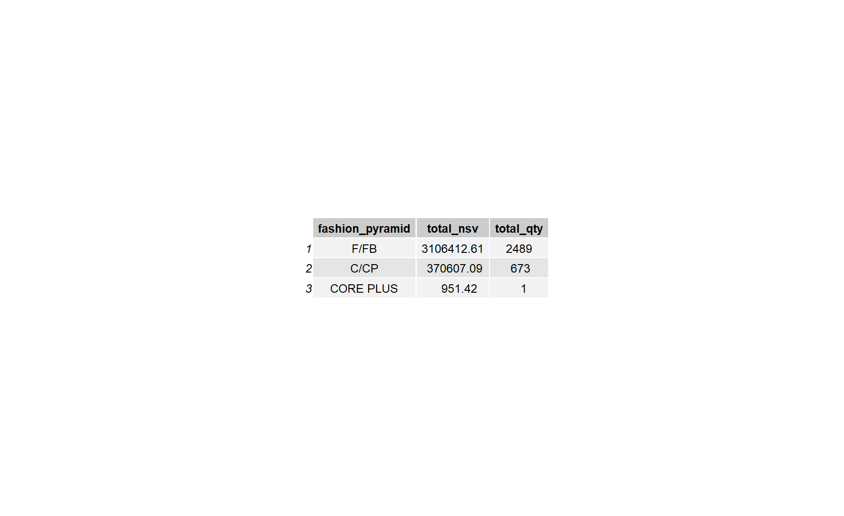
Fashion Pyramid Vs Sales Summary

Slide 35

Ag Description Summary

Slide 36
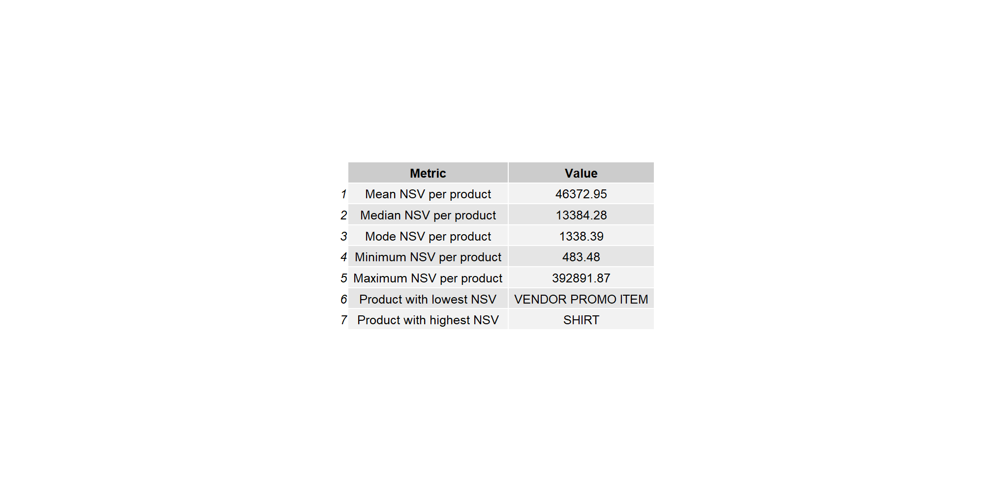
Newsimplifiedproduct Nsv Descriptives

Slide 37
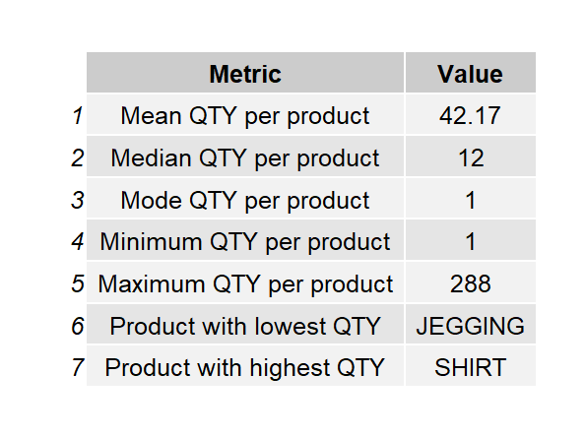
Newsimplifiedproduct Qty Descriptives

